Slide 1
LINKS TO HAVE OPEN ON THE DAY…
https://docs.microsoft.com/en-us/xamarin/xamarin-forms/
https://github.com/redth/ResizetizerNT
https://docs.microsoft.com/en-us/xamarin/xamarin-forms/deploy-test/hot-restart
https://docs.microsoft.com/en-us/xamarin/xamarin-forms/xaml/hot-reload
https://materialdesignicons.com/
https://snppts.dev/
https://github.com/CliffAgius/NDCOslo2020
https://appcenter.ms/orgs/XamarinTalks/applications

Slide 2
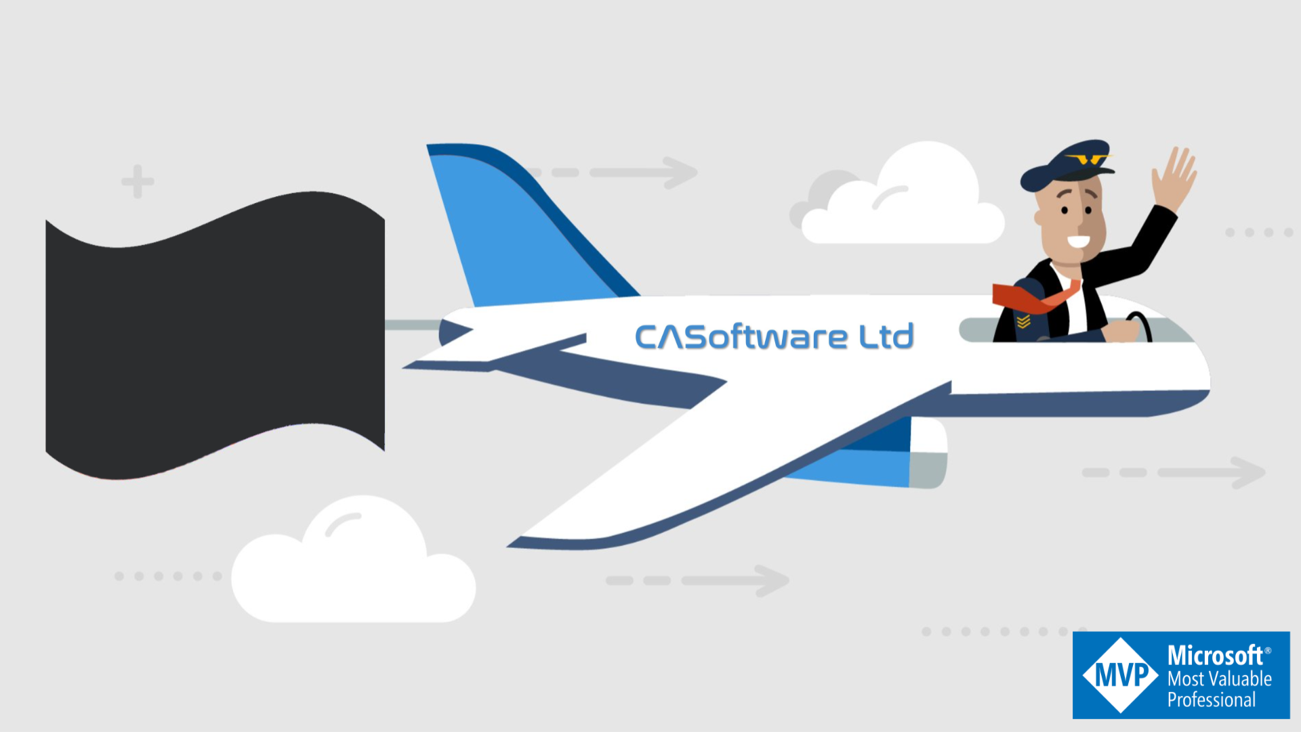
Xamarin File New to running on your phone.
@cliffordagius
CliffordAgius@CA-Software.co.uk
Notes:
Here today to talk about using Robotics, Software and IOT and the journey I have taken over the past 6-8 months to give someone a hand…

Slide 3
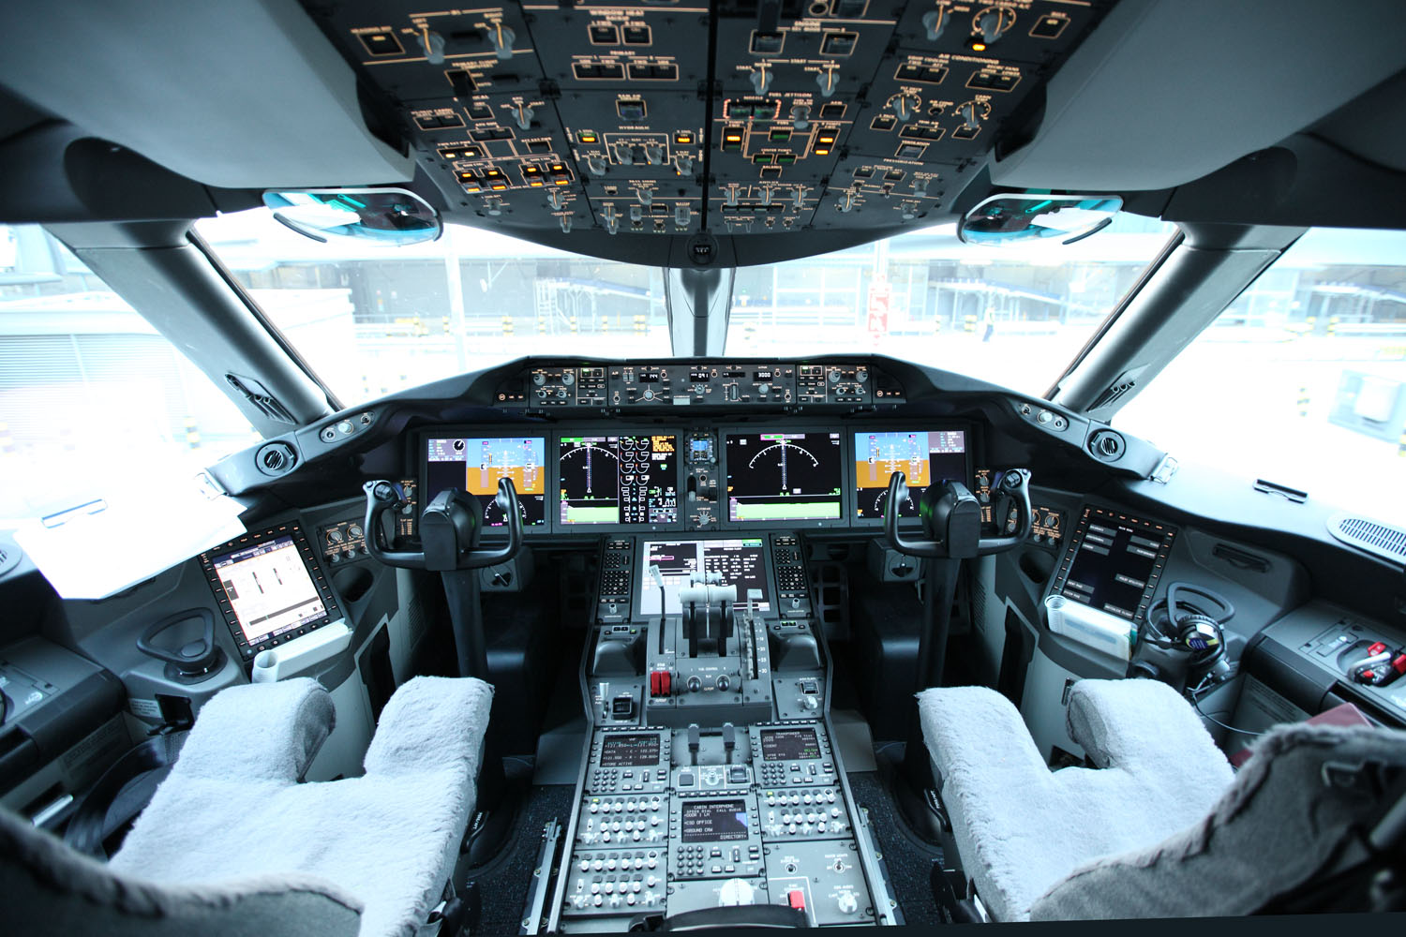
About Me…
JOB(s)
Airline Pilot for Major UK Airline
Freelance Developer (.Net / Xamarin / IOT)
PASSIONS
Code/Developing making things.
Electronics/IoT design and build
Learning new things.
Supporting others to do things differently
Road and Mountain Biking
Family
@cliffordagius
Notes:
Blah…

Slide 4
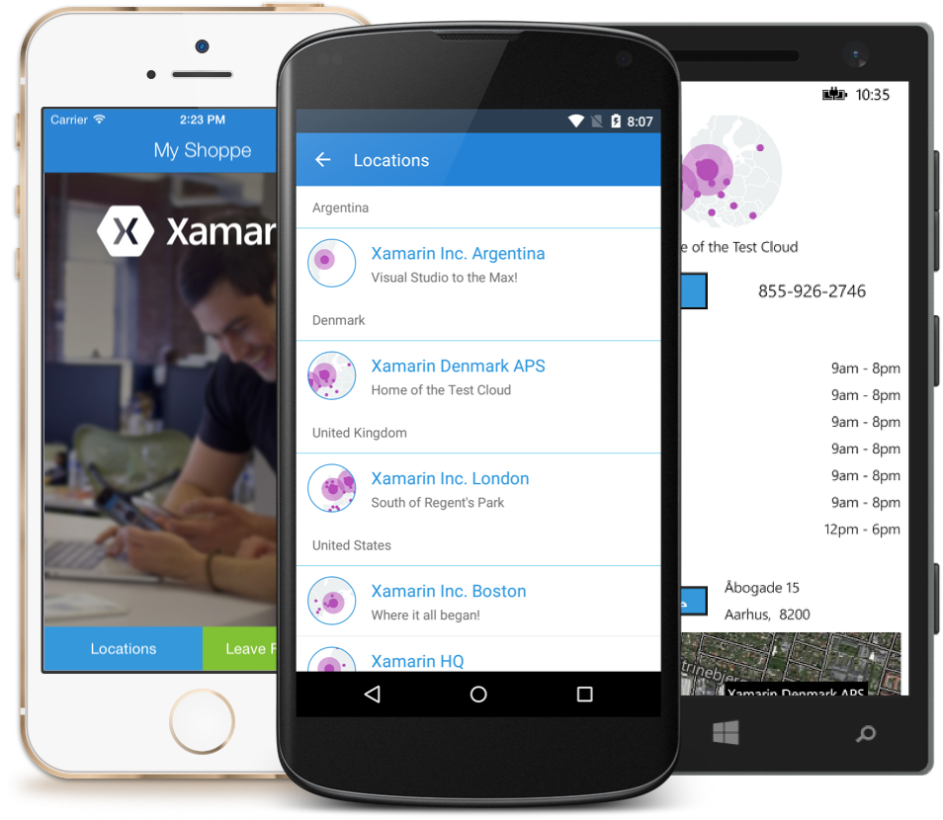
Mobile App.
Needs to be on all platforms
Needs to look and feel native to the user
Needs to be able to access the BT stack
Needs to be C# as I know C#
Needs to have accessibility built in.

Slide 5

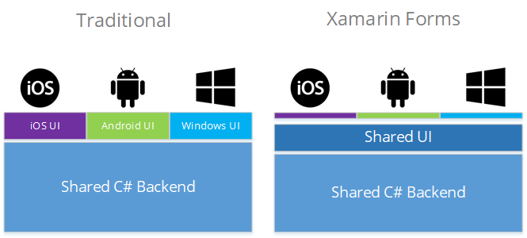
@cliffordagius

Slide 6
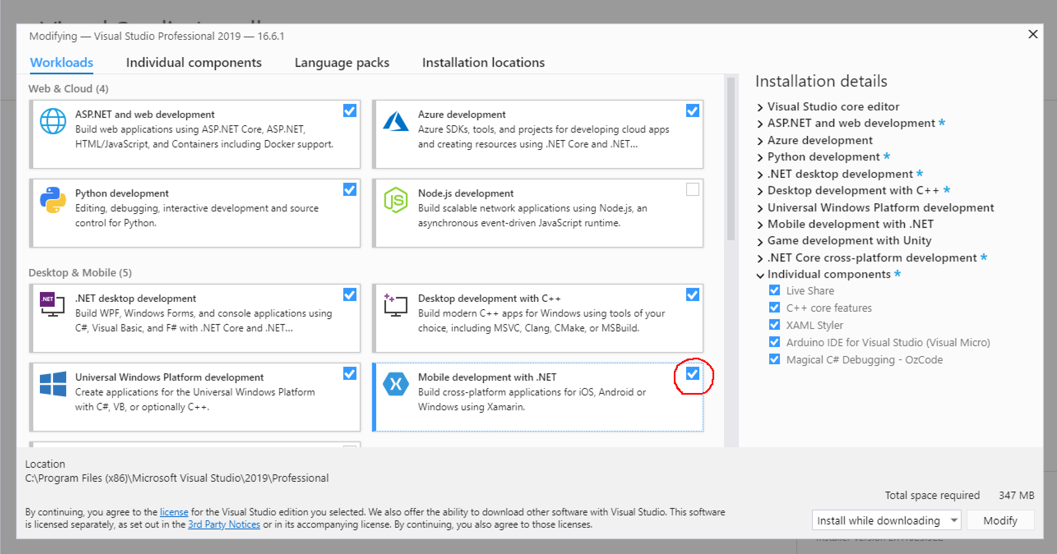

Slide 7

Visual Studio
Notes:
You could use the Arduino IDE which is very basic think NotePad+++
VSCode can be used but again under the hood it’s just matching the Arduino IDE controls.
But we all love VS so I use VS and VisualMicro so I have all the power of Visual Studio and can play IOT at the same time, you even get Interllisense…

Slide 8
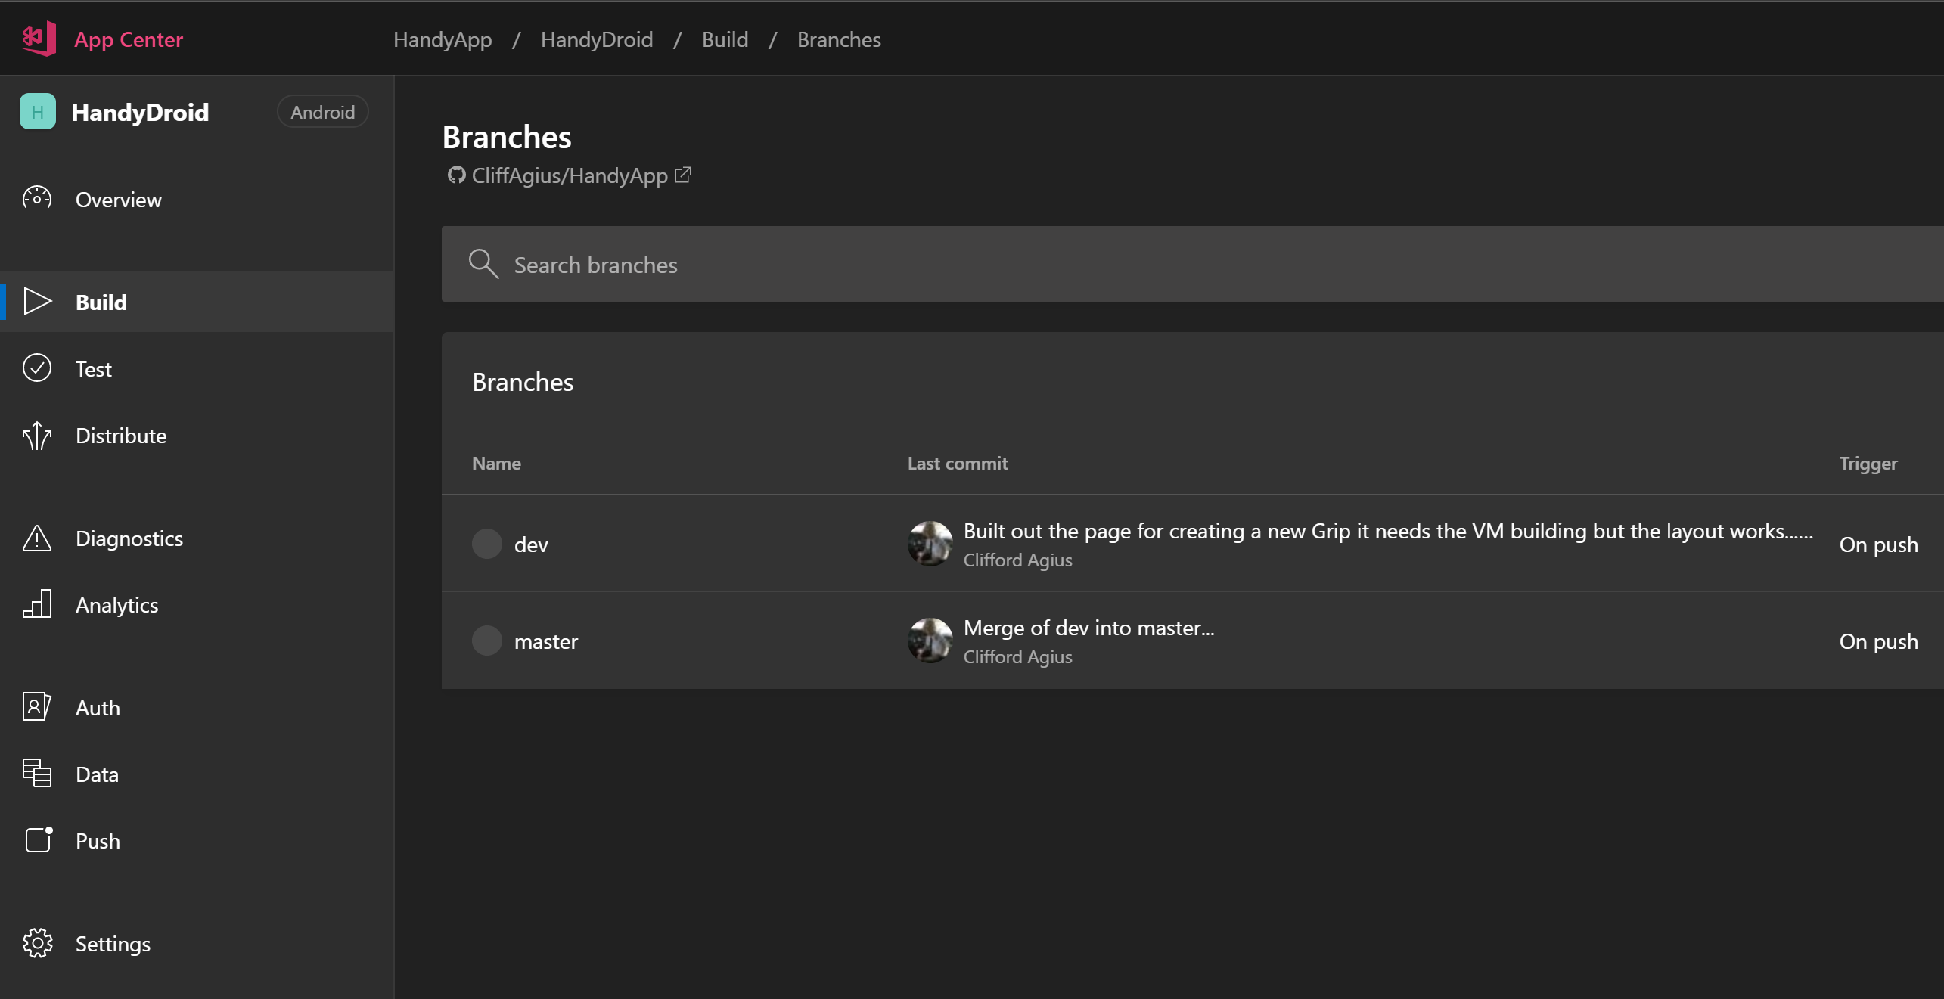
@cliffordagius

Slide 9
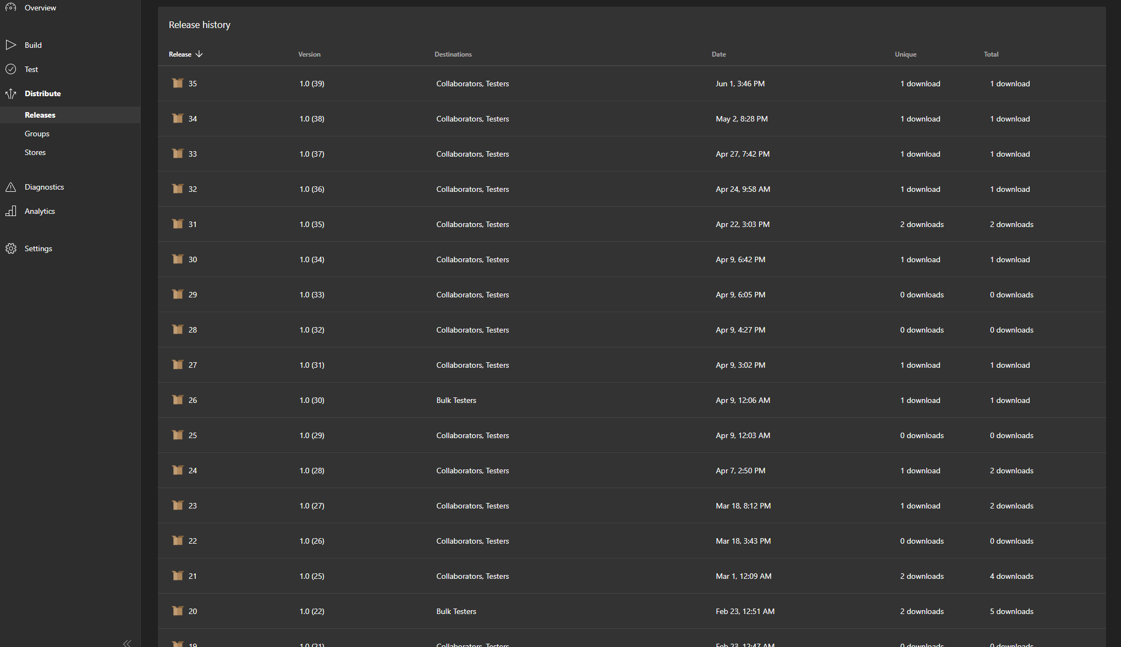

Slide 10
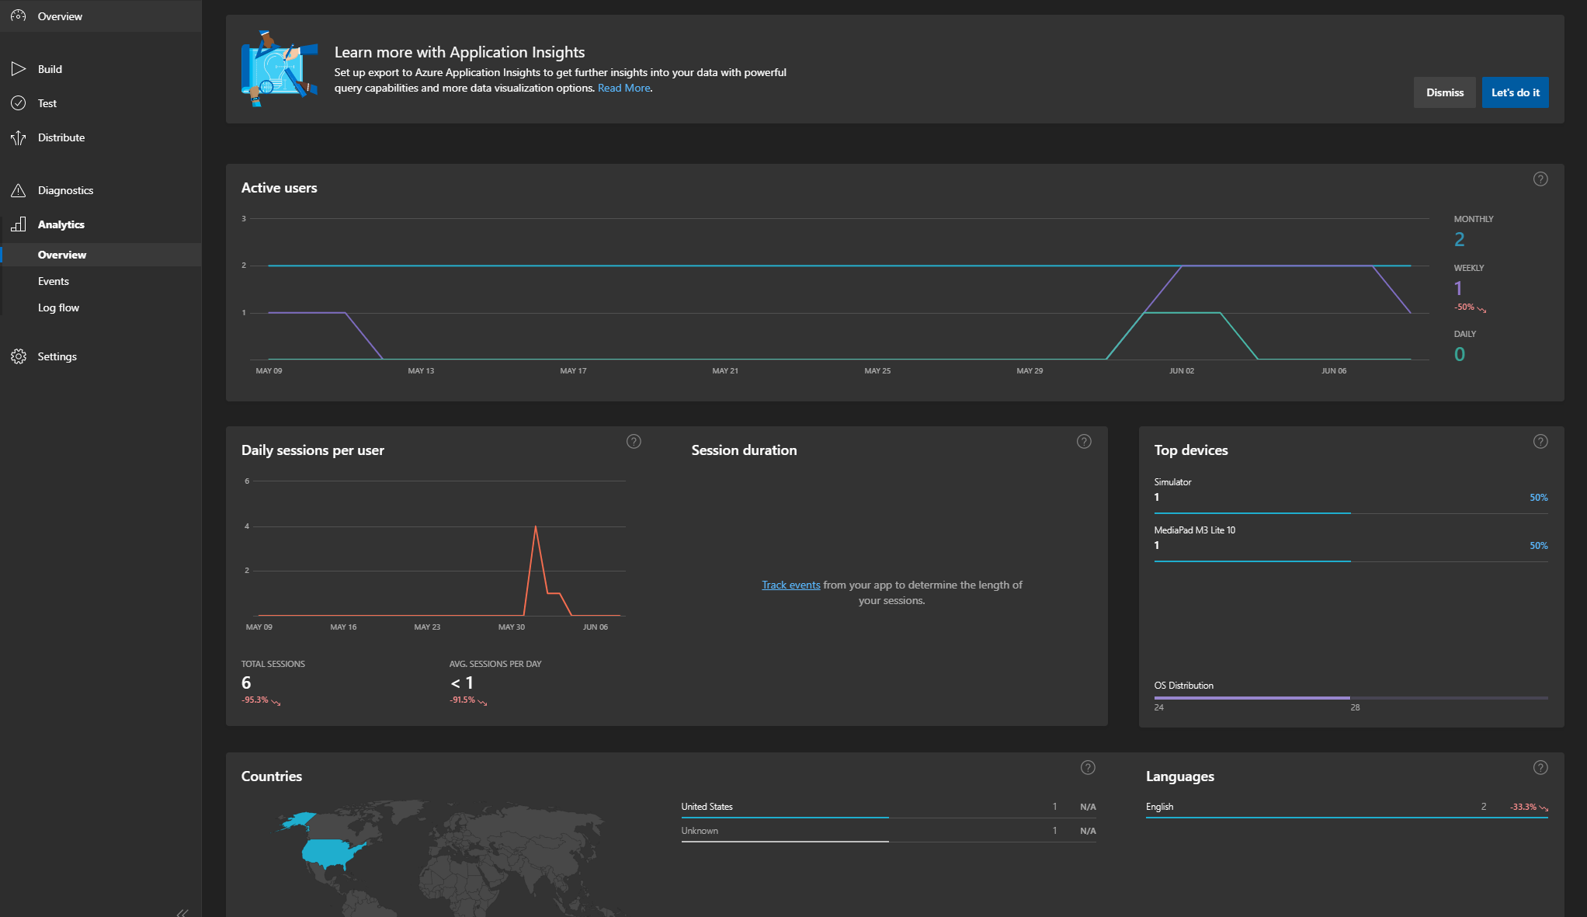

Slide 11
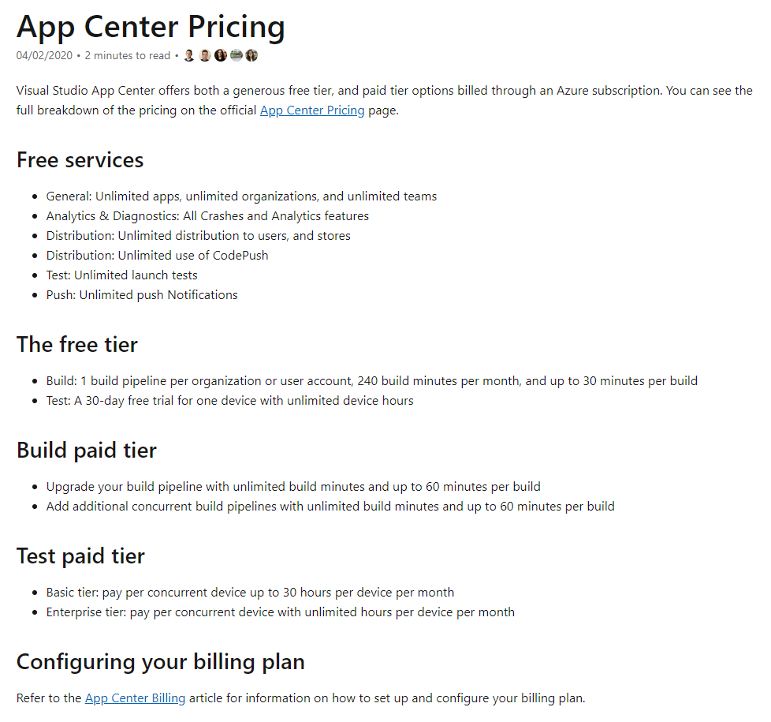
@cliffordagius

Slide 12
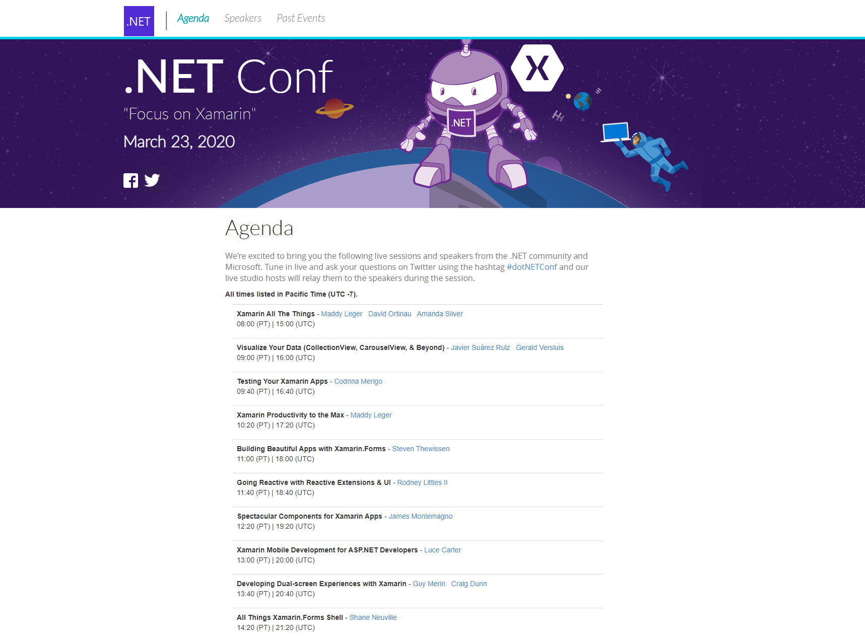
@cliffordagius

Slide 13
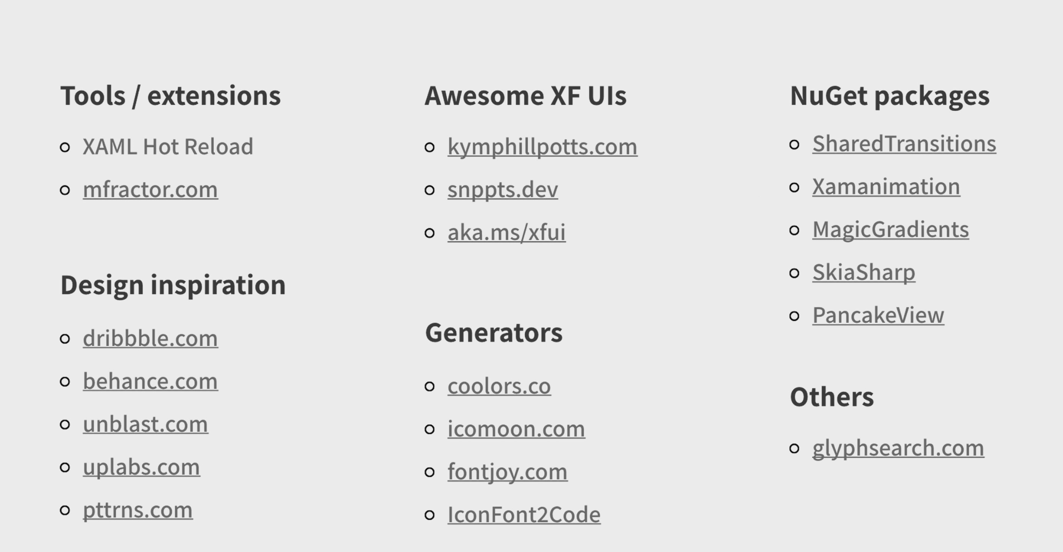
STEVEN THEWISSEN
https://www.thewissen.io/
.NET Conf March 2020

Slide 14
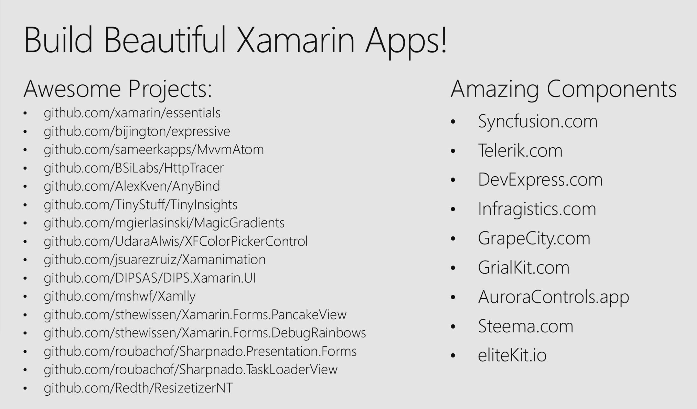
STEVEN THEWISSEN
https://www.thewissen.io/
.NET Conf March 2020

Slide 15
Questions…
@cliffordagius
CliffordAgius@CA-Software.co.uk

